Slide 1
Hardware and Protocol to watch for IoT
Nguyễn Quốc Đính
twitter: @nqdinh
github: nqd
SG, 24/4/2016

Slide 2
Terms
“Internet of Objects”
“Machine to Machine Era”
“Internet of Everythings”
“Web of Things”
…

Slide 3
Terms
The Internet of Things (IoT) is the network of physical objects - devices, vehicles, buildings and other items - embedded with electronics, software, sensors, and network connectivity that enables these objects to collect and exchange data.
(Wikipedia https://en.wikipedia.org/wiki/Internet_of_Things )

Slide 4
Network architecture - Standards
TCP/IP, no property protocol
IETF 6LoWPAN

Slide 5
Data transport
RESTful (HTTP)
IETF's Constrained Application Protocol (COAP)
MQTT
HTTP 2.0
Fog computing (?)

Slide 6
Datalink
4G/3G/GPRS
IEEE 802.11 (Wifi)
IEEE 802.15.1 (Bluetooth)
IEEE 802.15.4 (Zigbee/6LowPAN)

Slide 7
Hardware to watch

Slide 8
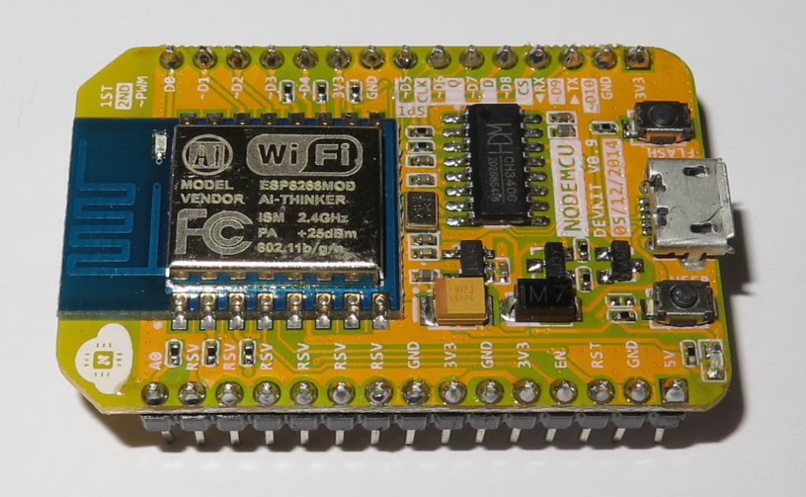
Wifi - Easy to connect
ESP8266 (esp8266.com)
Arduino IDE compatible
Very cheap (< $2)
Very popular to tinker
ESP32
Wifi + BLE
TBA

Slide 9
Wifi - More serious
TI (CC3200)
Mediatek Lab http://home.labs.mediatek.com/
Marvell https://github.com/marvell-iot/aws_starter_sdk

Slide 10
6LowPAN - Lowest power requirement
2.4 Ghz: TI CC2650
Sub Ghz: TI CC1310
Need gateway (Linux power usually)

Slide 11
Cellular
Not really cheap solution (> $20)
particle.io module
Mediatek MT2502

Slide 12
Projects to watch
Really low power (6LowPAN, Bluetooth)
Contiki http://www.contiki-os.org/
RIOT https://www.riot-os.org/
Zephyr (Linux foundation) https://www.zephyrproject.org/
Wifi
FreeRTOS + LwIP/PicoTCP
OpenWRT (Linux)

Slide 13
Cloud to use

Slide 14
What to use
Build your in house
Use public cloud

Slide 15
Public cloud
AWS IoT
IBM Bluemix

